Slide 1
“Recipe Data Analysis Project” GitHub Link for Project Files:- https://github.com/hemantg111/Rapidious-Project.git
By
Hemant Gupta LinkedIn- https://www.linkedin.com/in/hemant-gupta-4914baa6

Slide 2
Overview
To address the KPIs and fetch the important insights from the datasets.
Tool Used:- ‘Power BI’ & ‘Python’.
KPI [1] :-
What are the most common ingredients in highly rated recipes?
KPI [2] :-
Are there correlations between preparation time and recipe ratings?

Slide 3
Steps Taken to Analyze the Recipe Data
Understanding the Problem:
The task involves analyzing the recipe data based on various parameters to retrieve actionable insights from the dataset.
Data Collection:
Collected raw data in the form of a CSV file.
Upload the data into Google Collab using the ‘Upload' option.
Data Cleaning:
The raw data contained issues such as null values, unnecessary data, duplicate entries, and blank data fields.
Performed data cleaning by using Python pandas, Matplotlib, Seaborn library.
Loaded the cleaned data into Power BI Desktop to create visuals based on the specified parameters.
Data Analysis:
Created visuals, including Bar Charts, Heat Map Visuals, to analyze the data.
Identified trends and extracted insights from the visuals data.
Interpreting Results:
Derived insights from the visuals.
Compiled a final report detailing the data analysis findings.

Slide 4
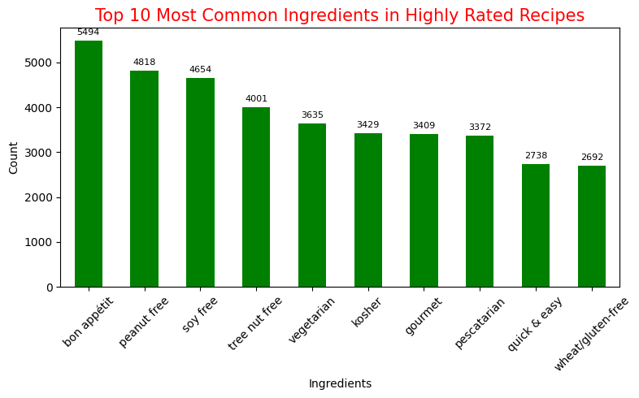
Top 10 most common ingredients
Visualization Type:- Bar Chart
Insights:-This chart displays the top 10 most common ingredients in highly rated recipes.
The most frequent ingredient in the highest-rated recipes is 'Bon Appetit,' appearing 5,494 times.
The second most common ingredient is 'Peanut Free,' found in 4,818 highly rated recipes.
Other prominent ingredients include 'Soy Free,' 'Tree Nut Free,' 'Vegetarian,' and more.

Slide 5
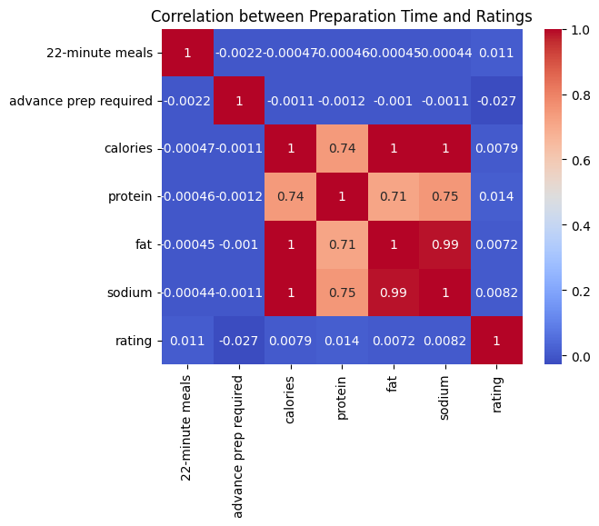
Correlations Between The Preparation-Related Columns And The Ratings
Insights:- This chart displays correlations between the preparation-related columns and the ratings:
There are strong positive correlations among the nutritional factors:
Calories and fat have a perfect correlation (1.0), meaning they are closely related and increase together in the dataset.
Sodium and fat also have a very high correlation (0.99), indicating dishes with high fat content also tend to have high sodium.
Protein shows a moderate to high correlation with calories (0.74), fat (0.71), and sodium (0.75), suggesting that protein-rich dishes also tend to be higher in calories, fat, and sodium.
Conclusion:- The heatmap indicates that none of the preparation-related columns (including meal preparation time, advance prep requirement, or nutritional factors) have direct correlation with the rating. This suggests that other factors (possibly taste, presentation, or subjective preferences) may be more important in determining the rating of a dish rather than its nutritional content or preparation time.

Slide 6
Thank You

